Slide 1
Microsoft Intune: Mobile Device Management & Mobile Application Management
Dec 2018
M5
Microsoft 365 Device Series

Slide 2
Agenda
Manage updates in Intune
Modern Device Management
Mobile Applications Management

Slide 3
Evolving Business Needs
Recent Past | Mobile First, Cloud First
9-to-5 Monday-Friday employees at work | 24x7x365 blur of work & personal activity
PCs on a LAN, connected to domain | Laptops, tablets, phones anywhere (on any network)
Corporate supplied and managed devices | Corporate and BYOD, business & personal apps/data
One device ecosystem | Heterogeneous ecosystems (Windows, iOS, Android)
Extended operating system/servicing lifecycle | A faster upgrade cadence; shorter device lifecycle
On-premises applications and file sharing | SaaS applications and file sharing services
Access controls contained within organizational | Access controls span organizations, apps, individuals
Deep corporate management controls and policies | Lighter cloud-based management with fewer controls
Malware as vandalism and criminal activity | Malware as espionage and weaponry
Network perimeter as a viable defense boundary | Must operate under assumed breach of network
Vertically-integrated devices for task workers | Dynamically adapting devices for task workers
Notes:
[Positioning]
So what do we mean when we say that business needs are evolving? Many things: a shift towards a mobile workplace, a realization of heterogeneous ecosystems, bring your own device (BYOD) and choose your own device (CYOD) scenarios, the cloud, and more. Most importantly, the rate of change is increasing, which is why we’re investing in new scenarios and capabilities: We want Windows to remain the best-managed platform, regardless of how you are using it.

Slide 4
Traditional on-prem
Active Directory
Domain Join
Group Policy
System Center Configuration Manager
Notes:
[Positioning]
This is the current situation on how enterprise customer manage and deploy their Windows.
It is the traditional way of managing windows for the past 20 years using these solutions like GPO’s, identity through Active Directory, windows deployment through SCCM.

Slide 5
Cloud
Traditional on-prem
Active Directory
Domain Join
Group Policy
System Center Configuration Manager
Azure Active Directory
Azure AD Join
MDM Policies
Microsoft Intune and other MDM
Notes:
[Positioning]
When we are talking about modernizing IT, we are thinking about moving customer cloud.
Microsoft has build all the assets over the years to support this.
But the important thing to understand here is that “ Cloud” is a mean and not a goal. The goal is not to move to customers to the cloud but to provide new value that we believed can be offer and deliver through cloud.

Slide 6
Modern IT
Traditional IT
Cloud
Windows 10 designed for modern IT
Notes:
[Positioning]
Realistically, we all know that these initiatives and new solutions about moving customer to the cloud will not happen at one shot and overnight.
When we are talking about modern IT, it is important to recognize that it will come to a point that the customers need to be in a Hybrid mode.
There will be customers that will be running completely to the cloud or will still on-premise or customers that will slowly adopt the cloud and will be on hybrid state between on-prem and cloud.

Slide 7
Management Choices
Available Choices
Identity | Active Directory Azure Active Directory
Management | Group Policy System Center Configuration Manager 3rd Party Infrastructure Management Microsoft Intune 3rd Party MDM
Updates & Upgrades | Windows Update Windows Server Update Services Software Update Point (System Center Configuration Manager) Microsoft Intune 3rd Party MDM
Infrastructure | On Premises Cloud
Ownership | Corporate Owned Choose Your Own Device (CYOD) Bring Your Own Device (BYOD)
Traditional Management
Modern Management
Works with existing infrastructure
Continued support for Group Policy and WMI
Advanced MDM support
Consistent across PC/phone
1st and 3rd party solutions
Notes:
[Positioning]
At a high level, we have two main choices: Traditional management, with Group Policy, System Center, and related components; and Mobile Device Management (MDM), which we added in Windows 8.1 and continue to enhance. In Windows 10, we’ll greatly expand the MDM capabilities while shifting to a consistent implementation across phone and PC devices, and of course we’ll support both our own Intune service as well as other third-party MDM solutions.

Slide 8

Understanding management choices through scenarios
I want to reduce device onboarding costs
My users
must have the same experience regardless of device
Scenarios
My management infrastructure must support WaaS
I want to take control of corporate mobile devices
Notes:
[Positioning]
We can demonstrate how this approach is used by looking at the Windows 10 security capabilities and aligning them to everyday security scenarios.
Use these slides to make Windows 10 management capabilities real for the customer, by showing how the capabilities align to the example scenarios that customers may need to address in their environment. Ask what scenarios matter to the customer, and work with them to map the capabilities to the scenario during the workshop.

Slide 9
Recommendations
Prepare existing infrastructure for Microsoft 365
Get current
with System Center Configuration Manager
Add a mobile device management capability
Licensing
- Windows 10
- Office 365 ProPlus
Group Policy
Management and deployment of on-premises Windows 10 devices with System Center Configuration Manager
Lay the foundations for mobile device management support and future support of Windows 10
Trial Microsoft Intune or connect with System Center Configuration Manager
Single pane of glass administration for on-premises and mobile device management
Notes:
Check relevance for Microsoft 365
Notes
Recommendations vary by customer; ask the customer what blockers they foresee for adoption of Windows 10 in their environment after talking through each recommendation at a high level

Slide 10
Manage updates in Intune

Slide 11
Always up to date for latest productivity and security capabilities
PRODUCT UPDATE
PRODUCT UPDATE
AGILE UPDATE CYCLE
PRODUCT UPDATE
PRODUCT UPDATE
2 UPDATES PER YEAR
Notes:
This brings us to Microsoft 365. With smaller product Updates approximately twice per year, providing IT with the ability to stay secure and up-to-date.
And with Windows 10 in-place upgrades, moving from Windows 7 or Windows 8.1 to Windows 10 is simple—no imaging is required, and all apps, data, and settings are automatically preserved.
With Windows as a Service, we’ve simplified the delivery and management of Windows, while providing you the control and flexibility your IT department needs, improving productivity for your IT staff and your end users, all while increasing security across your organization.
We understand that technology is moving so rapidly that IT is challenged to keep up.
We are committed to continuous improvements for Windows as a Service. A few examples are:
Feature updates continue to get easier. Continued improvements in the biannual feature updates ensure settings are preserved, existing apps continue to work, and removed apps don’t come back. Later this year, organizations can expect a 35% size reduction in feature updates.*
Quality updates continue to get smaller. Monthly quality updates are made smaller with the use of express updates, coming soon for System Center Configuration Manager and third-party tools.

Slide 12
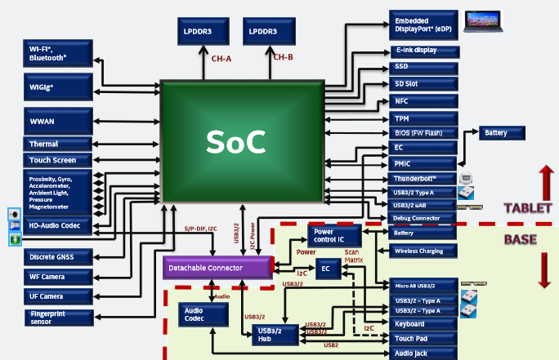
Supporting Hardware Innovation with Windows 10
Hardware is changing rapidly
Integration
Performance
Battery life
Software is a key piece
Power management
Performance tweaks
New hardware features to leverage
Windows 10 is enhanced with each feature update release
Notes:
A few years ago, the interfaces between Windows and the hardware that it was running on were abstracted as much as possible. Add a new set of drivers and you’d be set to go. But with the current pace of hardware innovation, and the change in the nature of that hardware, that’s all changed.
Now, in order to get the best performance, battery life, and overall experience from new devices, there is often a need to make enhancements to Windows itself. With the ability to release new Windows 10 feature updates every six months, we can continue to make the necessary tweaks to Windows 10 to offer the best experience. [This is the crux of our Windows silicon support policy: New Windows releases are needed to support new generations of processors.]

Slide 13
Improving Productivity with Windows 10
Continual improvements: New features twice per year, adding value and improving productivity
Minimized end-user disruption by having less change with each release
Notes:
Of course Windows 10 is also important for the productivity of the information workers who use it for their day-to-day jobs. We always strive to add features to Windows 10 with each release – by doing releases more frequently we can deliver improved productivity frequently.
Compared to our previous “every few year” release schedules, we also deliver these new productivity features incrementally, and as a result we can minimize the end-user disruption that can result from large changes [and potentially eliminate the need for expensive end-user training for each release].

Slide 14
Windows as a Service
A way of building, deploying, and servicing Windows
Building
Deploying
Servicing
Continual, ongoing development
Deliver new features twice per year
In the open, to enable and encourage feedback
Stay current with simple, automated update process
Unmatched application compatibility
Flexible timelines, methods, tools
Simplified process, to ensure consistency, stability and reliability
Delivered using cumulative updates
Eliminate platform fragmentation for all Windows-based devices
Notes:
So what exactly is Windows as a service then? With Windows 10, we’ve introduced a brand new way of building, deploying and servicing Windows – three very distinct changes, but it’s important to understand each one separately.
First, we are building Windows differently – we are always working on new features, and making those available to anyone interested so they can follow along with our development process and provide feedback, well before we ship these features.
Next, we are moving to a new simple update process that automatically preserves all apps, data, and settings, making it easier than ever to deploy new releases. At the same time, we’re ensuring that application compatibility is great, and that we can provide choices in tools and deployment timelines.
And finally, from a servicing perspective we are simplifying the processes that we use for patching Windows each month – we want to make sure that we maintain the best possible stability and reliability for all customers.
[ It’s important to note that we’re not talking about “Windows as a subscription” here. Windows as a service is not at all related to licensing or existing offerings like Windows E3/E5 subscriptions. Instead, it’s all about the three changes we just mentioned. ]

Slide 15
Improving Windows as a Service
Continuing improvements to address customer feedback
Current Challenges
Announced Changes
Windows 10 releases are unpredictable
“Two to three times per year” (with exceptions)
Release timeframes are not disclosed in advance
Windows 10 servicing timelines are unclear
“We service two CBB releases at all times, with a 60-day grace period”
Customers are unable to predict end of servicing dates
Windows 10 updates are too large
Periodic feature updates and monthly quality updates are challenging to deploy due to their size
Windows 10 releases are predictable
Twice every year, targeting March and September
Windows 10 servicing timelines are clear
Each Windows 10 feature release will be serviced and supported for 24 months from the date of release
Windows 10 updates are measurably smaller
Improvements available in Windows 10 1607 and Windows 10 1809, with further improvements coming earlier next year(as previously announced)

Slide 16
Windows as a Service – W10 Servicing Channels
Choose the servicing channel from which you want groups of devices to receive updates. The following channels are available:
Semi‐Annual Channel
Semi‐Annual Channel (Targeted)
Windows Insider ‐ Fast
Windows Insider ‐ Slow
Release Windows Insider
Plan and Prepare
Windows Insider Preview Channel
Pilot
Semi-Annual Channel
Broadly Deploy
Semi-Annual Channel
Prepare for new release by evaluating new features
Provide feedback on changes, any issues encountered
Validate apps, infrastructure, and hardware to prepare for broad deployment
Lab machines, some IT devices, developers
Early adopters, volunteers, IT
Information workers
General population
NUMBER OF DEVICES
Time
Release
Notes:
Windows as a Service is the way to update Windows 10 devices. With Windows 10, new Feature Updates and Quality Updates include the contents of all previous updates. As long as you've installed the latest update, you know your Windows 10 devices are up-to-date. Unlike with previous versions of Windows, you now must install the entire update instead of part of an update.

Slide 17
Staying Current Key things to know about Windows as a Service
2018
2019
2020
Start as early as possible
Think of this as a process, not a project
Windows 10 1709
Windows 10 1803
Windows 10 1809
Windows 10 1903
Plan & Prepare
Pilot
Broad Deployment

Slide 18
What needs to change Creating teams responsible for implementing the process
IMPLEMENT FEATURES
PILOT
BROADLY DEPLOY
PLAN AND PREPARE
Plan and Prepare Team
Working with Insider Preview builds
Providing feedback on features and compatibility
Identifying needed feature implementation teams
Deployment Team
Performing business-critical app validation
Conducting initial pilots for each release
Driving broad deployments of each release
Reacting to issues encountered
Feature Implementation Teams
Formed as needed to implement new features
Can be done synchronously with the deployment of a release or later
Personaliy
Notes:
It’s useful to think of the described tasks as being performed by “teams” whose responsibilities map closely to the tasks described previously:
The “Plan and Prepare” team gets ready for what’s next.
The “Deployment” team performs pilot and broad deployments.
“Feature Implementation” teams are formed as needed to implement new Windows 10 features.

Slide 19
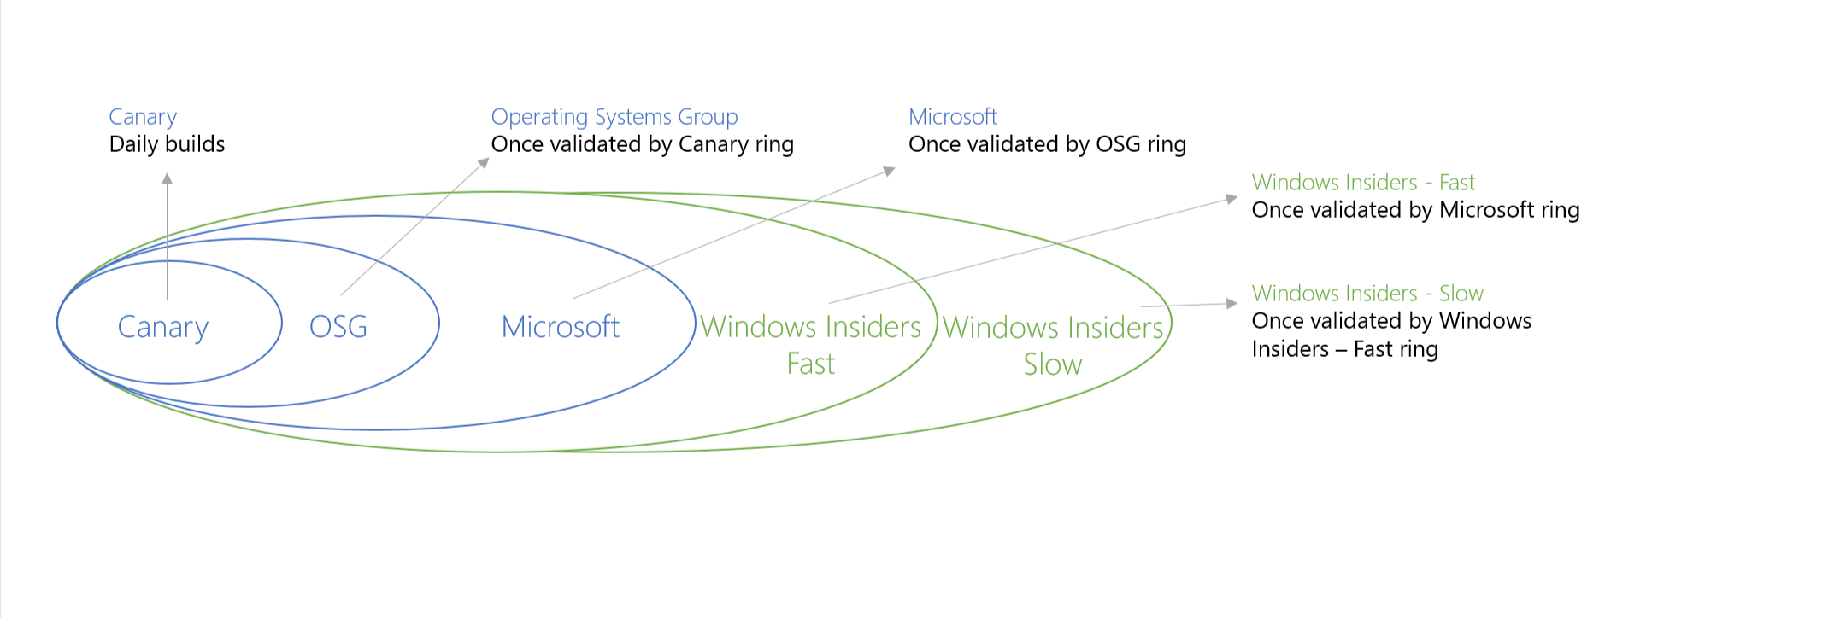
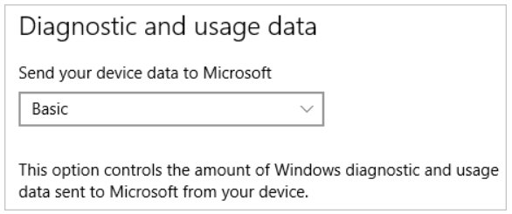
Microsoft Intune Updates Management
Update compliance reporting
On Windows devices, Feedback & diagnostics > Diagnostic and usage data must be set to at least Basic.
Create and assign update rings
To update Windows 10 PCs, they must be running at least Windows 10 Pro with the Windows Anniversary update.
Notes:
Refer to this page to check the process:
https://docs.microsoft.com/en-gb/intune/windows-update-for-business-configure

Slide 20
Modern Device Management

Slide 21
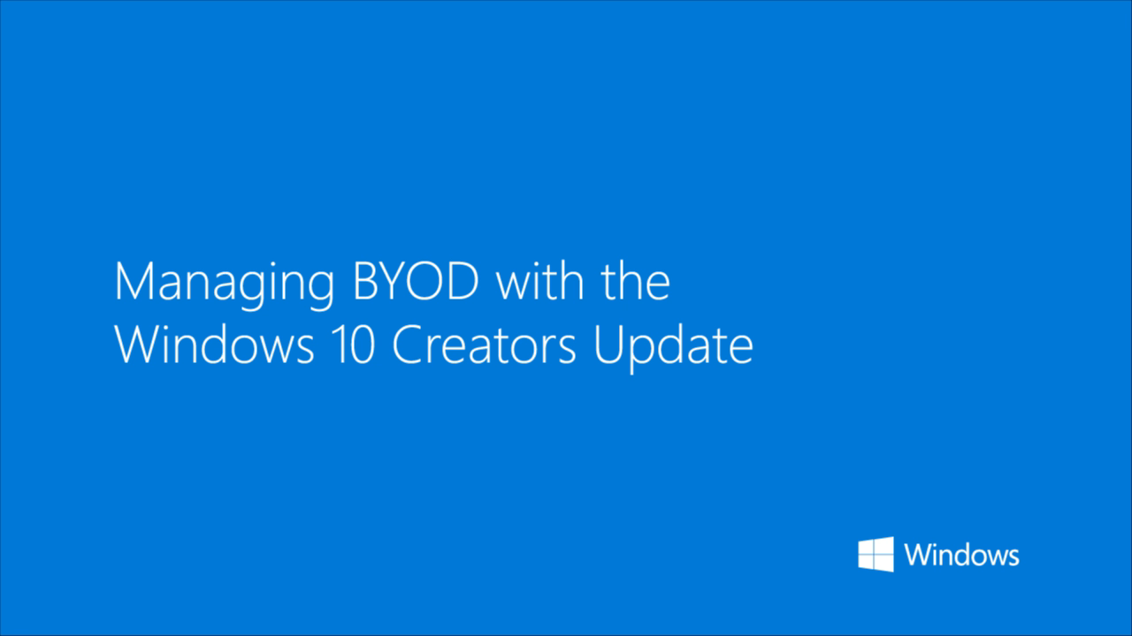
Managing BYOD for Windows with Creators Update
Notes:
Reference: http://aka.ms/entwin10cu

Slide 22
Mobile Device Management with Windows 10
Advantages
Unified management constructs/low TCO
Use MDM for mobile devices, extend that to Windows devices
Address the rise of mobile users
Manage without requiring device to be on corporate network
Personal device management options
Management options at app & data level without taking over device
Evaluate & Adopt
Tools to help assess current state & features to encourage migration to modern mgmt.
Built an understanding of critical group policies/MDM gaps based on customer data
Analysis tools for IT to assess group policies used & start migration to MDM
Establish
Investments to make modern management powerful, simple & cost-effective
Rich and powerful diagnostics support
Dynamic Management
Robust, secure & scalable architecture
Enhanced MDM policies for Windows PC management
Expand
Management options for both personal & corporate owned devices
Mobile Application Management for Windows to manage BYOD devices
Notes:
[Positioning]
TCO = Total Cost of Ownership
Advantages
We are trying to combine all management tools to one
Addressing the adoption of mobile users
Providing more management tool even on personal devices
Evaluate and Adopt
Developing new tools to adopt the modern management

Slide 23
Group Policy vs MDM Policy
Group Policy
Active Directory
Best management for Domain-joined PC and Tablets
Provide flexible and fine-grained configuration settings
GPO takes precedence over MDM Policy if similar set of settings are applied
MDM Policy
MDM Provider
Best for managing “on-the-go” devices (iOS, Android, Windows Phone, Non-domain-joined machines)
XML Based Policy
Lightweight Management (MDM Policy is a subset of the capabilities of Group Policy)
Note: All Group Policy Changes documented here https://go.microsoft.com/fwlink/?linkid=829685
Notes:
NOTE – Emphasize MDM policy does not have as much capability as AD GPO
[Positioning]
At a high level, we have two main choices: Traditional management, with Group Policy, System Center, and related components; and Mobile Device Management (MDM), which we added in Windows 8.1 and continue to enhance.
In Windows 10, we’ll greatly expand the MDM capabilities while shifting to a consistent implementation across phone and PC devices, and of course we’ll support both our own Intune service as well as other third-party MDM solutions.
Reference: https://blogs.technet.microsoft.com/enterprisemobility/2016/03/23/the-path-to-modernizing-windows-management/

Slide 24
Device Management and Policy Options
Who owns?
Company owned devices
BYOD (Personal Owned)
Joined
Domain joined
AAD joined
AAD Account
Policy
Group Policy
MDM policy (Intune) or 3rd Party or Mobile Application Management (MAM) for Windows
Configurations
Security Baseline
Configuration policies, etc.
Notes:
[Positioning]
Now let’s take a closer look at Microsoft Device Management and Policy Options.
With Intune, you can provide employees with access to corporate applications, data, and resources from anywhere on almost any device, while helping to keep corporate information secure.
With Intune’s Mobile Device Management (MDM) capabilities, you can:
Restrict access to Exchange email based upon device enrollment and compliance policies
Deploy certificates, Wi-Fi, VPN, and email profiles automatically once a device is enrolled for management
Simplify device enrollment in the case of large scale deployments using Apple Configurator or Intune service accounts
Provide a self-service Company Portal for users to enroll their own devices and install corporate applications across iOS, Android, Windows and Windows Phone
Intune also provides Mobile Application Management (MAM) capabilities, you can:
Maximize mobile productivity with Intune-managed Office mobile apps while still protecting corporate data by restricting actions such as copy/cut/paste/save outside of your managed app ecosystem
Extend these same management capabilities to your existing line-of-business apps using the Intune App Wrapping Tool
Provide secure viewing of content using the Managed Browser, PDF Viewer, AV Player, and Image Viewer apps for Intune
Additionally, you can also manage PCs using Intune:
Provide lightweight, agentless management from the cloud or deliver agent-based management
Connect Intune to System Center 2012 R2 Configuration Manager to manage all of your devices on-premises and in the cloud, including Macs, Unix/Linux servers, PCs, and mobile devices from a single management console
Provide real-time protection against malware threats on managed computers
Collect information about hardware configurations and software installed on managed computers
Deploy software based on policies set by the administrator

Slide 25
MDM Intune Policy Options
Configuration policies
These are commonly used to manage security settings and features on your devices
Examples include password, encryption, hardware, system, features, etc.
Device compliance policies
Compliance policies are used with conditional access policies to allow only devices that comply with compliance policy rules to access email and other services
Examples include PIN or password, email profile, minimum OS version, and Windows health attestation
Conditional access polices
Conditional access policies are set to conditional access policy to restrict access
Examples include device compliance status, the platform running on the device, and the type of apps used to access the services
Corporate device enrollment policies
Microsoft from virtually anywhere on almost any device, while helping to keep corporate information secure
Resource access policies
Microsoft Intune Wi-Fi, VPN, and email profiles work together to help your users gain access to the files and resources that they need to do their work wherever they are. Certificate profiles help secure that access
Notes:
Missing ADMX backed policy and MAM
[Positioning]
Microsoft Intune policies are groups of settings that control features on mobile devices and computers. You can configure and protect the devices using the policies. As you see, Microsoft Intune has far more than Windows health attestation policy setting to secure your devices. You create policies by using templates that contain recommended or custom settings, and then you deploy them to device or user groups.
Reference:
Configuration Policies
https://docs.microsoft.com/en-us/intune/deploy-use/windows-10-policy-settings-in-microsoft-intune
Device compliance policies
https://docs.microsoft.com/en-us/intune/deploy-use/introduction-to-device-compliance-policies-in-microsoft-intune
Conditional access polices
https://docs.microsoft.com/en-us/intune/deploy-use/restrict-access-to-email-and-o365-services-with-microsoft-intune
Corporate device enrollment policies
https://docs.microsoft.com/en-us/intune/deploy-use/enable-access-to-company-resources-with-microsoft-intune

Slide 26


Flexible deployment and management options
Intune standalone (cloud only)
Configuration Manager integrated with Intune (hybrid)
IT
IT
Intune web console
Configuration Manager console
System Center Configuration Manager
Mobile devices and PCs
Domain joined PCs
Mobile devices
Notes:
Radhika to provide updated slide..
[Positioning]
This slide specifically shows the two scenarios that are available to customers today. On the left with Intune standalone, you’ll continue to be able to manage mobile devices and Windows PCs completely from the cloud using the Intune web console.
With the hybrid scenario on the right, System Center Configuration Manager is integrated with Microsoft Intune. Here you can manage both domain-joined PCs, Macs, Linux/Unix Servers, Windows Servers, as well as mobile devices from a single management console – the Configuration Manager console. You can extend device management to the cloud by integrating System Center 2012 R2 Configuration Manager with Microsoft Intune to manage corporate-connected PCs, Macs and Unix/Linux servers on-premises along with cloud-based mobile devices running Windows, Windows Phone, iOS, and Android, all from a single management console.
Both of these scenarios require an Intune subscription for MDM and MAM capabilities.

Slide 27

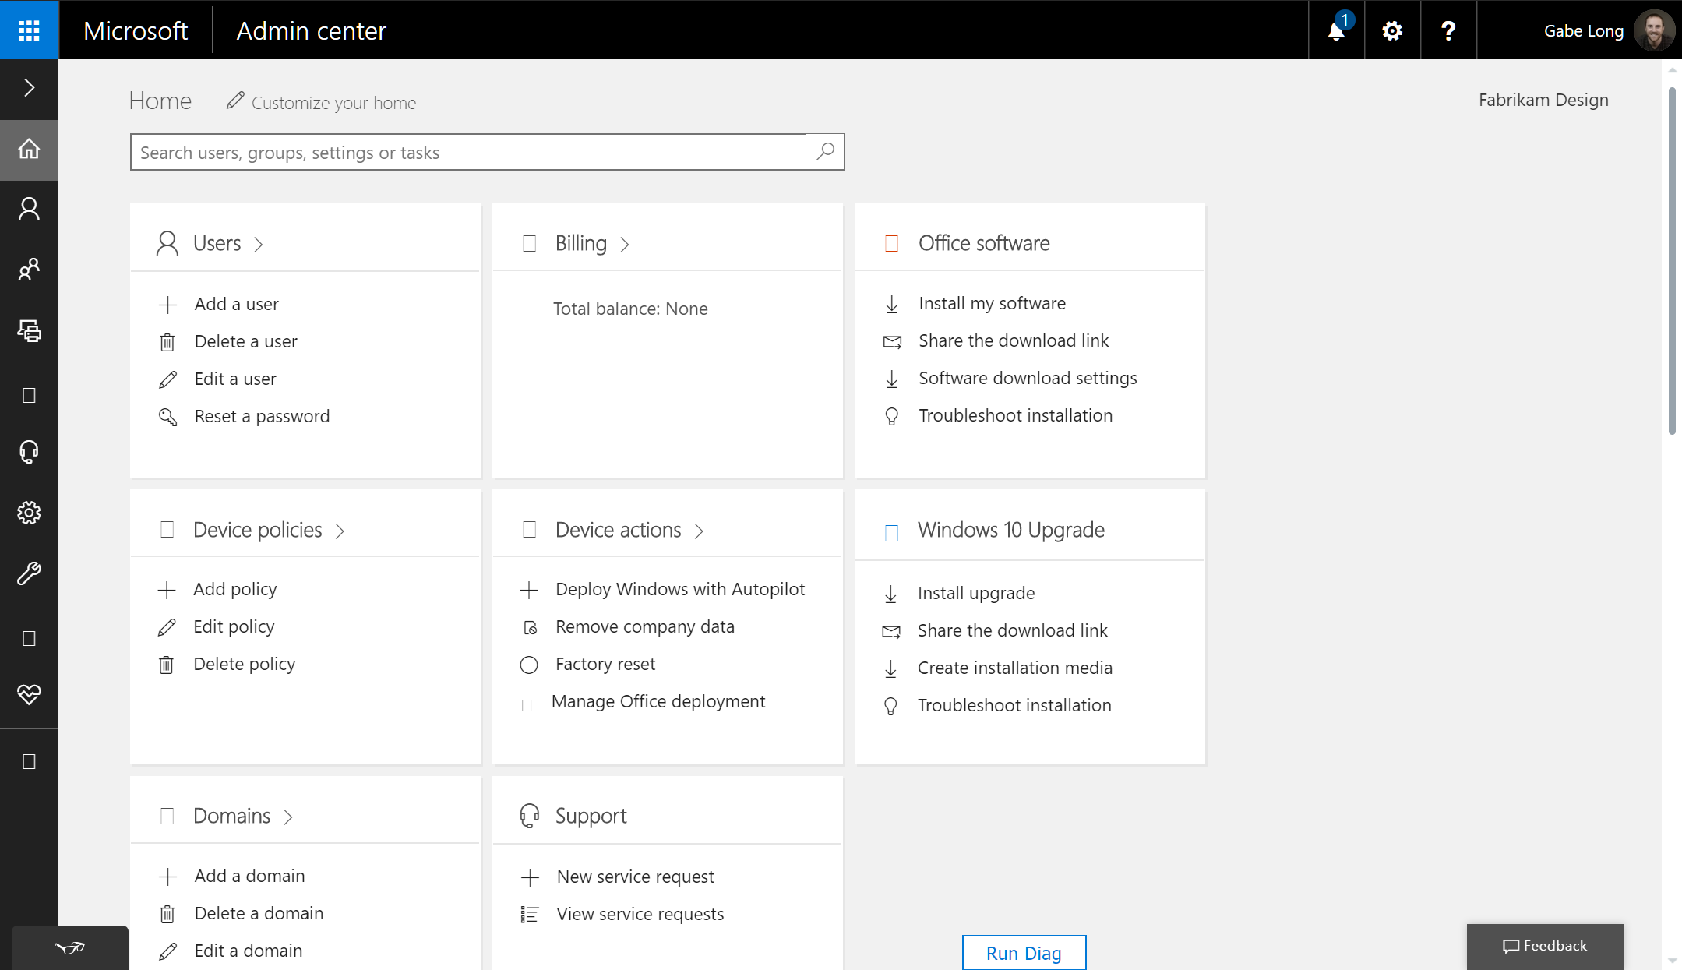
Management in Microsoft 365 Business
Notes:
Let’s begin by orienting ourselves in the Microsoft Admin Center. You’ll notice a direct mapping between three of four topic areas I just outlined and specific cards—one for users, and others for device policies and device actions. The fourth topic area maps to the Groups drop-down menu highlighted in the menu bar on the left. Together, they give you quick access to the full set of management capabilities in Microsoft 365 Business.
The policies that you create are specific to the device type and can be applied to specific groups of users. For example, this means that you could create one policy that applies to your executives and another that applies to everyone else.
For Android and iOS devices, you can add or edit application policies that protect Office apps and work files used by Office apps. You are able to control Windows 10 devices a bit more, so application policies can include additional settings, such as encryption and protection for network and cloud locations. You can also create device policies for Windows 10 devices that enforce settings like virus protection and automatic updates.

Slide 28


Revolution
ConfigMGR
Intune
Custom corp
image
WSUS
OEM image
Windows Update
for Business
Traditional
Modern
Security
tools
Corpnet
connection
Advanced Threat
Protection (ATP)
Any internet
connection
Active Directory and
Azure Active Directory
Azure Active
Directory
Application
stores
Microsoft Store for Business

Slide 29
Evolution
Co-management
ConfigMGR
Intune
Custom corp
image
WSUS
Azure Active
Directory
OEM image
Windows Update
for Business
Traditional
Modern
ConfigMGR
Intune
Security
tools
Corpnet
connection
Advanced Threat
Protection (ATP)
Any internet
connection
Allows organizations to take a first step toward Modern Management to build confidence and momentum
Intune is primary management solution
ConfigMGR is available as contingency
Active Directory and
Azure Active Directory
Application
stores
Azure Active
Directory
Microsoft Store for Business

Slide 30
Evolution
Traditional
Co-Management
Modern
Connectivity
Corpnet connection
Any internet connection
Any internet connection
Operating system image
Custom corp image
OEM image
OEM image
Identity
Active Directory and Azure Active Directory
Azure Active Directory
Azure Active Directory
Device management
System Center Configuration Manager (ConfigMGR)
ConfigMGR + Intune
Intune
Updates
Windows Server Update Services (WSUS)
WSUS + WUfB
Windows Update for Business (WUfB)
Security
Security tools
Security tools
Security tools
Applications
Multiple app stores
Multiple app stores
Microsoft Store for Business (MSfB)

Slide 31
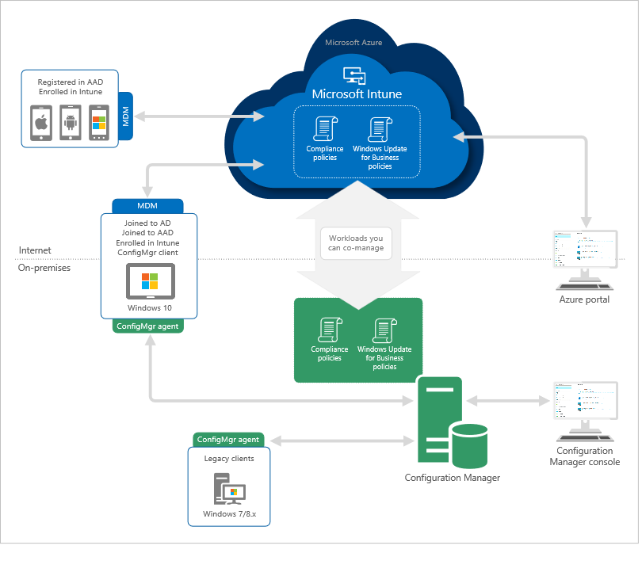
Co-Management Architectural Overview

Slide 32
Mobile Applications Management

Slide 33




Why do we need Mobile App Management?
REALITY
Users want to use personal devices for work
IT wants to allow it
PROBLEM
Users choose between productivity and losing control over devices
IT has to deal with heavyweight management and privacy issues
SOLUTION
Users enjoy productivity and control over their devices
IT enjoys lightweight management and peace of mind
IT Admin
User
PIN
Notes:
Change theme – Move to front
[Positioning]

Slide 34
How is MAM different from WIP?
WIP
MAM
MDM
SCCM
Notes:
[Positioning]
Windows Information Protection (WIP) is the technology and platform that enable Policies in Windows 10 that handles Data Leakage Protection (DLP) and MAM, MDM and SCCM are the management channels
Microsoft build the MAM layer on top of the WIP Platform.

Slide 35
Mobile Application Management (MAM) for Windows
Overview
Supported on phones and desktop
Offers corporate data security on personal devices
Uses Windows Information Protection policies to protect corporate data
Integrated with Azure Active Directory
Consistent admin and user experience as Intune MAM for iOS/Android
Supported Policies
Support for Enterprise Cloud & On-Premise resources
Copy/paste protection
Device Pin Policy
Selective wipe
Notes:
[Positioning]
Today using personal devices for work means subjecting these devices to management solutions that are capable of enforcing device wide policies on those devices. Users have to choose between productive on their personal devices and retaining control over them. Admins will have to deal with legal implications of heavy weight management of personal devices.

Slide 36
Mobile Application Management (MAM) for Windows
Requirements
Hardware
Windows 10 supported desktop/tablet/laptop
Windows 10 Mobile
Software
Client Operating System – Windows 10 1703 (Creators Update)
Azure Active Directory Premium
Intune MAM Service
Supported Apps
Support for both MAM & MDM
WIP enlightened apps: Can differentiate between work and personal (e.g. Office 365 Pro Plus 2016 or Office Mobile)
WIP aware apps: Signal to OS that they do not handle personal data and it is safe to encrypt their data
Supported via MDM only
Unenlightened apps
Notes:
[Positioning]
Mobile Application Management (MAM) is a lightweight management solution for BYO devices. MAM allows for protecting enterprise data on otherwise unmanaged device. MAM extends management to admin configured applications while the device itself is not managed. Only these managed applications have access to enterprise data. Enterprise data will be protected within these applications by using EDP (Enterprise Data Protection) technology.
MAM is intended as a management solution of personal devices.
To avoid encryption and potential wipe of personal data on user’s own devices we limited MAM management to apps that are WIP aware. (https://docs.microsoft.com/en-us/windows/uwp/enterprise/wip-hub)
List of enlightened Microsoft apps for use with Windows Information Protection (WIP) can be found: https://technet.microsoft.com/en-us/itpro/windows/keep-secure/enlightened-microsoft-apps-and-wip

Slide 37
Mobile Application Management (MAM) for Windows
Supported Apps
Support for both MAM & MDM
WIP enlightened apps: Can differentiate between work and personal
WIP aware apps: Signal to OS that they do not handle personal data and it is safe to encrypt their data
Supported via MDM only
Unenlightened apps
Supported Policies
Support for Enterprise Cloud & On-Premise resources
Copy/paste protection
Device Pin Policy
Selective wipe
Notes:
[Positioning]
Mobile Application Management (MAM) is a lightweight management solution for BYO devices. MAM allows for protecting enterprise data on otherwise unmanaged device. MAM extends management to admin configured applications while the device itself is not managed. Only these managed applications have access to enterprise data. Enterprise data will be protected within these applications by using EDP (Enterprise Data Protection) technology.

Slide 38
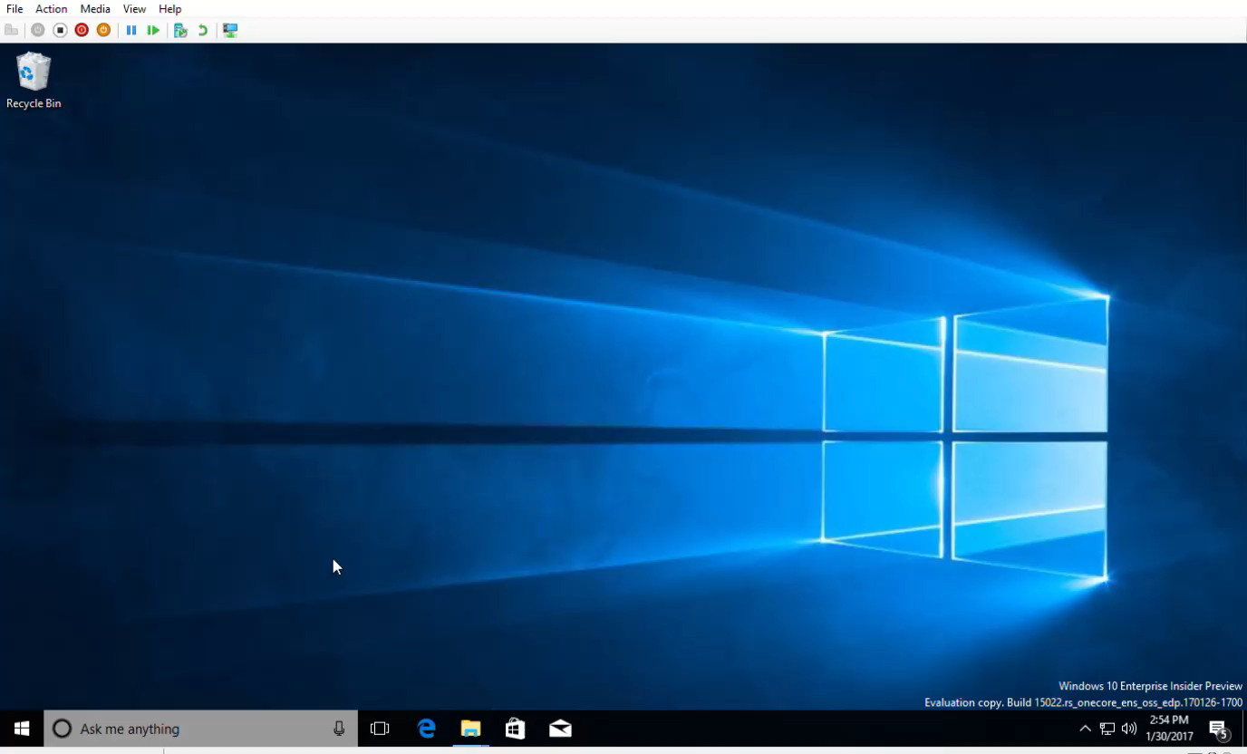
Notes:
[Positioning]

Slide 39
New MDM Capabilities
Dynamic CSP
allows you to manage devices differently depending on location, network, or time.
CleanPC CSP
allows removal of user-installed and pre-installed applications, with the option to persist user data
BitLocker CSP
used to manage encryption of PCs and devices
Network Proxy CSP
used to configure a proxy server for Ethernet and Wi-Fi connections
EnterpriseAppV Management CSP
used to manage virtual applications in Windows 10 PCs (Enterprise and Education editions) and enables App-V sequenced apps to be streamed to PCs even when managed by MDM
Notes:
[Positioning]

Slide 40
Dynamic Management
Overview
Windows 10 allows you to manage devices differently depending on location, network, or time. Settings will be enforced even if the device can’t reach the management server when the location or network changes.
Example
Managed devices can have cameras disabled when at a work location, the cellular service can be disabled when outside the country to avoid roaming charges, or the wireless network can be disabled when the device is not within the corporate building or campus.
Configurations
Geolocation, Network and Time-Based triggers
Policy Configuration and enforcement is local to the device
Policies are applied offline
Support both enable and disable by default
Notes:
[Positioning]
The DynamicManagement CSP allows you to manage devices differently depending on location, network, or time. For example, managed devices can have cameras disabled when at a work location, the cellular service can be disabled when outside the country to avoid roaming charges, or the wireless network can be disabled when the device is not within the corporate building or campus. Once configured, these settings will be enforced even if the device can’t reach the management server when the location or network changes. The Dynamic Management CSP enables configuration of policies that change how the device is managed in addition to setting the conditions on which the change occurs.
Reference: https://msdn.microsoft.com/windows/hardware/commercialize/customize/mdm/dynamicmanagement-csp

Slide 41
Labs
Lab 09 - Updates for Microsoft 365 and M365 Powered Devices
Lab 10 - Managing Users, Identity and Licensing for Devices using MS Intune
Lab 11 - Intune MDM and MAM management
https://m365.learnondemand.net/
Notes:
Refer to section 5.2 of the Lab Guide for the step by step guidance.

Slide 42
Thank You

